Slide 1
Chapter 10
Application Layer

Slide 2
Objectives
Roles of Application Layer
Client/Server model, P2P model, Daemon
Commonly involved protocols:
HTTP
DNS **
SMTP **
POP3 / IMAP**
FTP
Telnet
DHCP **

Slide 3
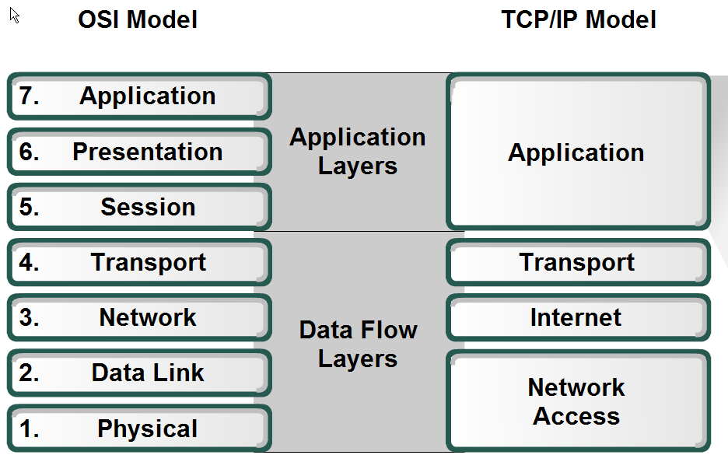

OSI and TCP/IP model

Slide 4
OSI Top 3 Layers
Application Layer
Provide network processes to application
Presentation Layer
Data representation and encryption
Session Layer
Session establishment, management and termination

Slide 5
TCP/IP Application Layer
The TCP/IP Application Layer’s functionality fits roughly into the top three layers of the OSI Model.

Slide 6
Network Architectures
Message exchange process can happen in the following models:
Client / Server model
P2P model

Slide 7
Client/Server Model
In the client/server model, the device requesting the information is called a Client and the device responding to the request is called a Server.
Servers usually are powerful computers that manage and share resources eg. web server, print server, database server
Clients do not share resources but request a server’s content or function
Resource sharing is centralized (on the server)

Slide 8
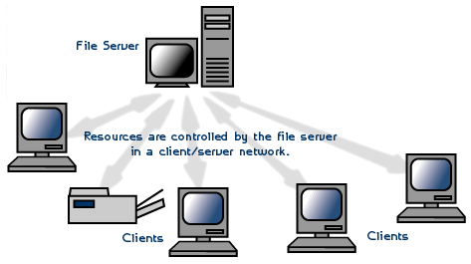

Slide 9
Daemon
Definition: a computer program that runs as a background process, rather than being under the direct control of an interactive user.
Eg. telnetd, ftpd
Server runs daemon to handle periodic service requests that a computer system expects to receive.
The daemon program forwards the requests to appropriate programs as required in the protocols.
Eg. Web server activates a daemon called HTTPD that continually waits for requests from the Web clients.

Slide 10
P2P model
Another type of network architecture is known as a peer-to-peer architecture because each node has equivalent responsibilities.
Each communicating node can be server or client.
Resource sharing is decentralized

Slide 11
P2P Applications
A P2P application allows a device to act as both a client and a server within the same communication.
Common P2P networks include:
G2
Bitcoin
BitTorrent
eDonkey

Slide 12
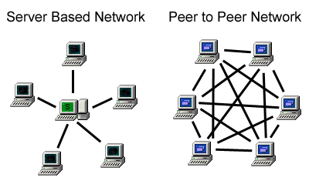

Slide 13
Application Layer Protocols
Domain Name System (DNS)
Hypertext Transfer Protocol (HTTP)
Simple Mail Transfer Protocol (SMTP)
Post Office Protocol v3 (POP3)
File Transfer Protocol (FTP)
Telnet
Dynamic Host Configuration Protocol (DHCP)

Slide 14
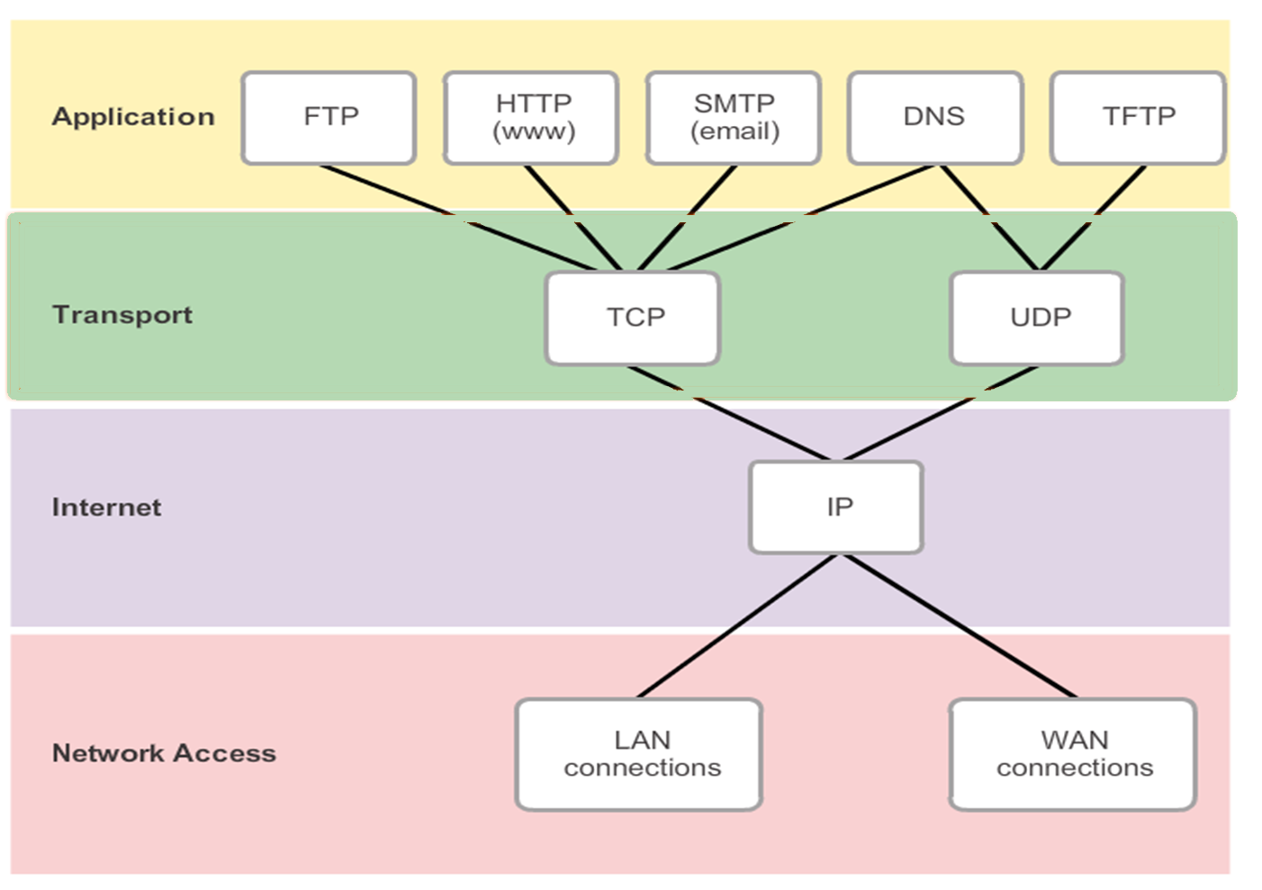

Slide 15
1. Domain Name System (DNS)
translates Internet domain name (in English words) to IP addresses (in string of numbers).
It provides name resolution service
The process is done automatically when an URL is entered
www.cisco.com → 198.133.219.25
The network devices will then use the IP address generated to route a message to the destination

Slide 16
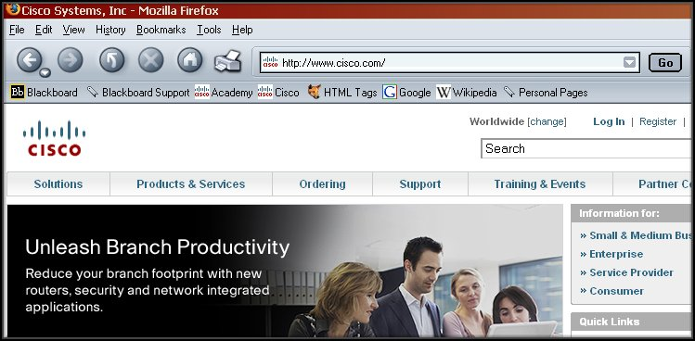
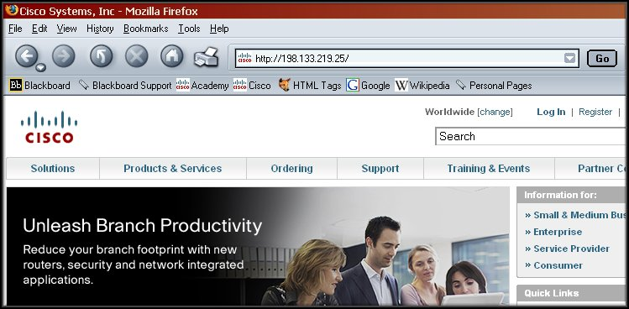

Slide 17
Cont’d…
Domain Name mapping database is stored in servers called Domain Name Servers.
When a client makes request, the server’s daemon named will lookup own database to see whether it can be resolved
If it is not able to resolve, it will contact other Domain Name Servers. Once it is found, it will return the result (matched IP address) to the requesting server, the server will then make a cache on it before replying to the client.

Slide 18
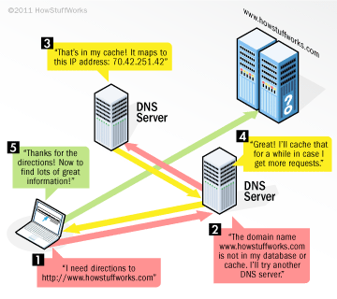

Slide 19
Cont’d…
Domain Name System is arranged in hierarchical way.
At the top of the hierarchy, the root servers maintain records about how to reach the top-level domain (TLD) servers, which in turn have records that point to the secondary level domain servers and so on.
DNS uses port 53
*port is a virtual connection point for application communication

Slide 20
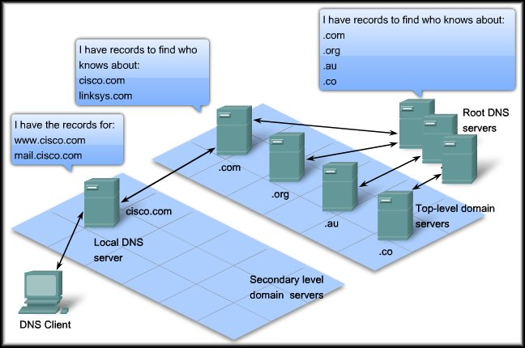
TLD servers
Video

Slide 21
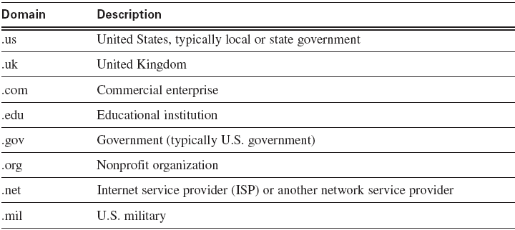
Cont’d…
top-level domains

Slide 22
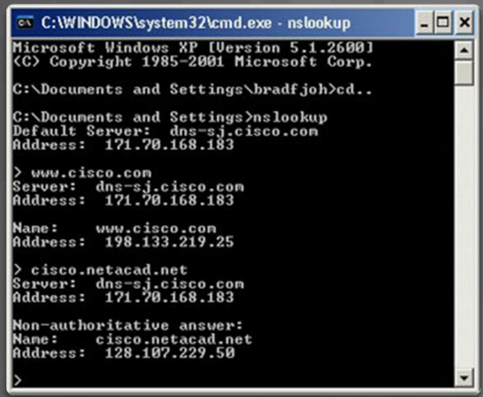
IP Addressing Services The nslookup Command
Nslookup - a utility that allows a user to manually query the name servers to resolve a given host.
Can also be used to troubleshoot name resolution issues and to verify the current status of the name servers.

Slide 23
2. Hypertext Transfer Protocol (HTTP)
HTTP defines how web pages are formatted and transmitted, and what actions Web servers and browsers should take in response to various commands.
HTTP uses port 80

Slide 24
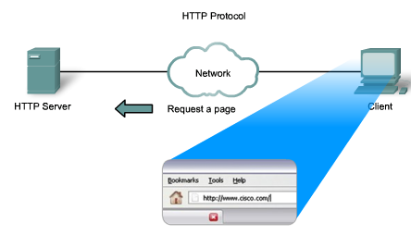

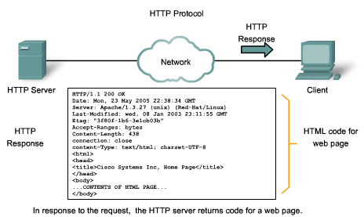
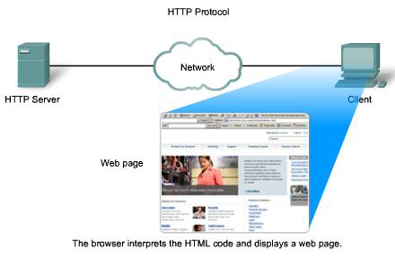

Slide 25
Cont’d…
HTTP categories the message types into three:
GET, POST, and PUT.
GET is a client request for data. A web browser sends the GET message to request pages from a web server.
POST and PUT are used to upload data to the web server. When user enters data into a form embedded in a web page, POST includes the data in the message sent to the server. PUT uploads resource or content to web server. (upload / modify web server contents)

Slide 26
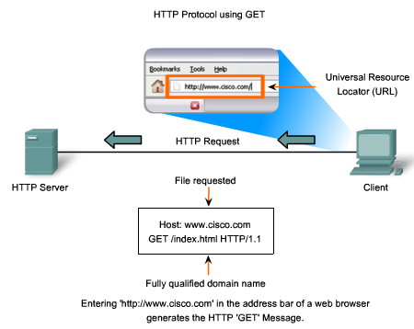
1
2

Slide 27
Cont’d…
HTTP is not a secure protocol as message send / received can be easily intercepted and read
HTTPS → Hypertext Transfer Protocol Secure
encrypts an HTTP message prior to transmission and decrypts a message upon arrival (using Secure Socket Layer, SSL)

Slide 28
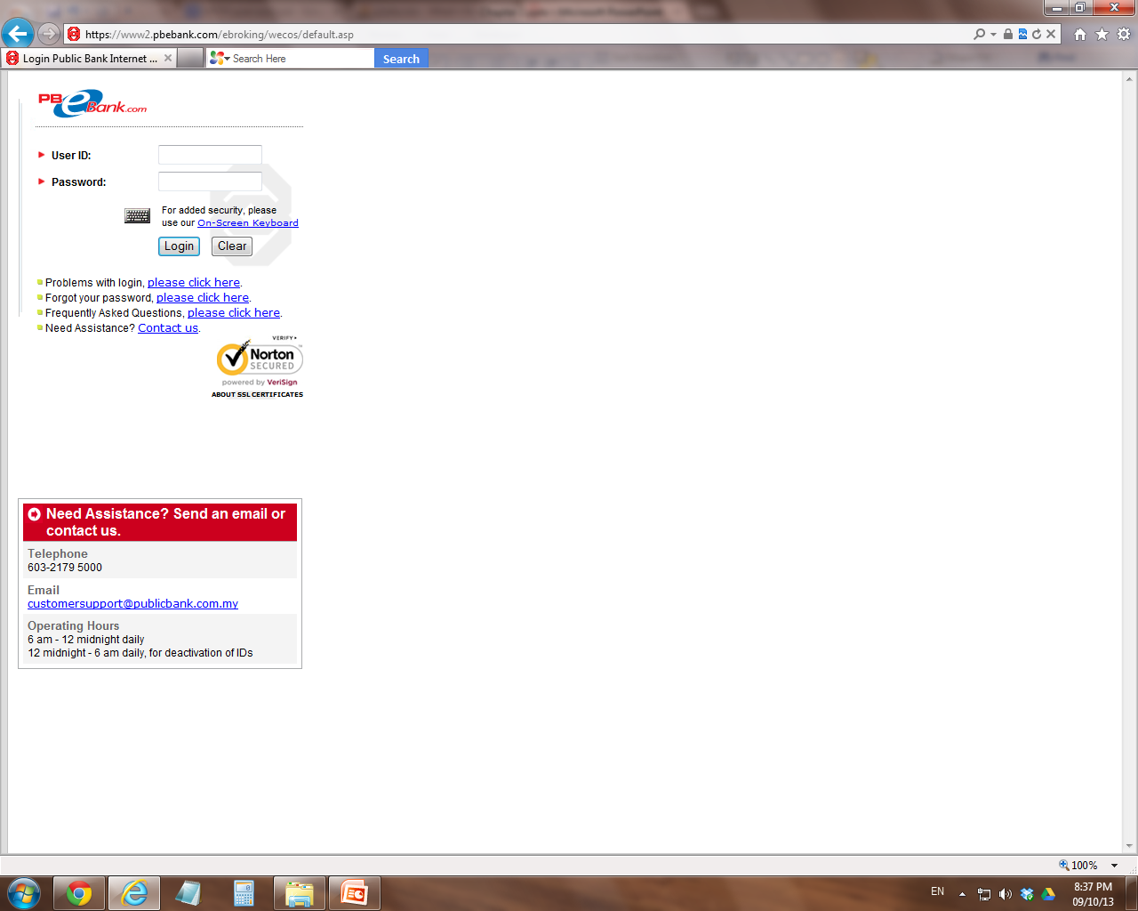

Slide 29
3. Simple Mail Transfer Protocol (SMTP) / Post Office Protocol (POP) & IMAP
They are protocols used for email delivery.
SMTP is generally used to send messages from a mail client to a mail server.
SMTP uses port 25
POP & IMAP used to retrieve e-mail from a mail server. The newer version, POP3, can be used with or without SMTP.
POP uses port 110 while IMAP uses port 143

Slide 30
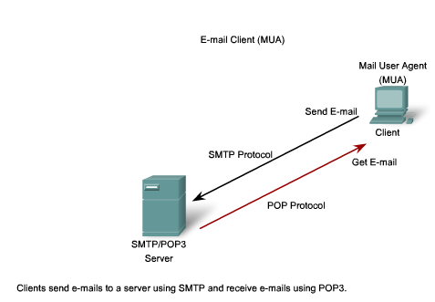
MS Outlook, Gmail,
Yahoo!mail
1
/ IMAP Protocol
2
/IMAP

Slide 31
Email server processes
The e-mail server operates two processes:
Mail Transfer Agent (MTA)
Mail Delivery Agent (MDA)
MTA is responsible in forwarding email to correct destination server
MDA is responsible in placing email in appropriate user’s mail box

Slide 32
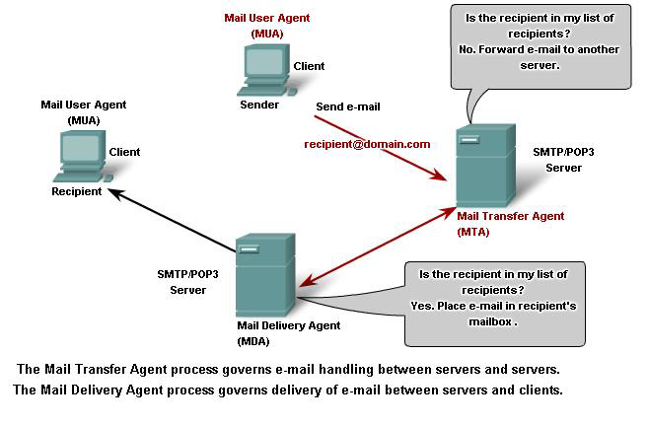
1
4
2
3

Slide 33
POP vs IMAP
POP: When using POP, emails are typically downloaded from the server to the client device. The messages may be removed from the server after download, depending on the client settings.
IMAP: With IMAP, emails remain stored on the server, and the client device accesses them without necessarily downloading them. Changes made on one device are synchronized with the server, providing a consistent view of emails across multiple devices.

Slide 34
4. Files Transfer Protocol (FTP)
FTP defines how files are exchanged over the Internet
FTP is most commonly used to download a file from a server using the Internet or to upload a file to a server (eg. uploading a Web page file to a server)
FTP uses port 20 (data port) ,21 (control port)

Slide 35
Cont’d…
When user download files from a server, it is known as PULL.
When user upload files to server, it is known as PUSH.

Slide 36
Cont’d…
FTP requires two separate TCP connections
The client establishes the first connection to the server on TCP port 21 (control port). This connection is used for control traffic, consisting of client commands and server replies.
The client establishes the second connection to the server over TCP port 20 (data port). This connection is for the actual file transfer and is created every time there is a file transferred.

Slide 37
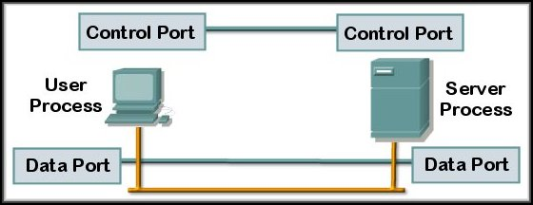
Client initiates a TCP control connection on Port 21. Username and password….
21
20
For each file transferred, TCP opens and closes a Data connection on Port 20.

Slide 38
5. Dynamic Host Configuration Protocol (DHCP)
Each machine that can connect to the Internet needs a unique IP address
DHCP – A communication protocol that automatically and dynamically assign IP address (and other related info) to device in a network
It provides IP address lease service
Without DHCP, the IP address must be entered manually at each computer in a network
DHCP uses port 67, 68

Slide 39
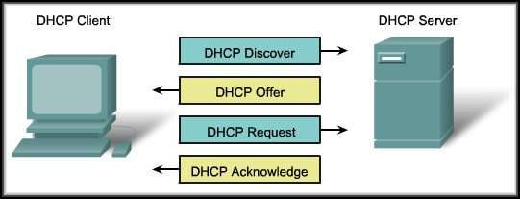
How DHCP works?
S1. Client broadcasts a DHCP Discover frame (using port 68) to find a DHCP server available. There may be more than one available.
(DHCP server maintains a pool of IP addresses and leases an address to any DHCP-enabled client when the client is powered on.)

Slide 40
Cont’d…
S2. A DHCP server responds with a DHCP Offer frame (using port 67) containing a lease time, an IP Address, Subnet Mask, and addresses for a Default Gateway and DNS Server.

Slide 41
Cont’d…
S3. The client responds by broadcasting a DHCP Request that identifies the server and the lease offer it is accepting.

Slide 42
Cont’d…
D
O
R
A
S4. If the offer is still valid, the server returns a DHCP Acknowledgement (ACK) and records that information as used. If it is no longer valid (time-out or taken by someone), a DHCP Negative Acknowledgement (NAK) is sent and the process DHCP Discover begins again.

Slide 43
6. Telnet
A communication protocol for remotely accessing (log in) to a computer.
HTTP and FTP protocols allow you to request specific files from remote computers, but not to actually be logged on as a user of that computer.
With Telnet, you log on as a regular user with whatever privileges you may have been granted to the specific application and data on that computer.
Telnet uses port 23

Slide 44
Objectives
Roles of Application Layer
Client/Server model, P2P model, Daemon
Commonly involved protocols:
HTTP (web protocol)
DNS (IP addressing services)
SMTP (email protocol)
POP3 / IMAP (email protocol)
FTP (file sharing protocol)
Telnet (remote access protocol)
DHCP (IP addressing services)

